Slide 1
Corporate Credentials
All Rights Reserved @ 2020-21

Slide 2
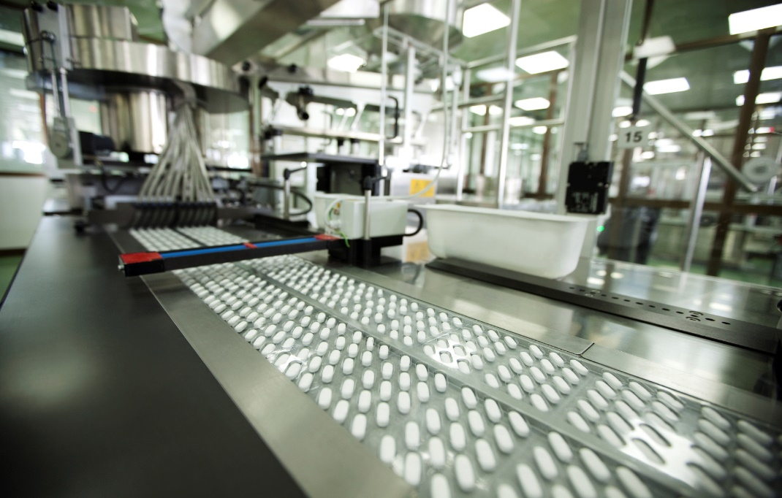
An Introduction
Maxtar Bio- Genics is a pharmaceutical manufacturing facility located on K.No. 705, Nalagarh Road,Malku Majra, Baddi Dist. Solan (HP) which is about 05 km from Baddi City in Himachal Pradesh, India
This facility is designed to manufacture, pack, analyze, store and distribute various pharmaceutical dosage forms, namely
Oral Solid Dosage Forms Tablets (General)
Oral Solid Dosage Forms Tablets (Beta Lactam)
Oral Solid Dosage Forms Capsules (General)
Oral Solid Dosage Forms Tablets (Beta Lactam)
2007
(Maxtar Bio-Genics)
2011
(Arika Healthcare)
2023
New Plant
1991
(Uni-Medicos)
1998
(Uni-Pex Pharmaceuticals)
A pharmaceutical retail unit and a start-up
By looking into the domestic market with their own brand name Uni-Pex Pharmaceutical was established and manufacturing unit was set.
WHO-GMP plant was set up by name Maxtar Bio – Genics to enter into international market
To enter into deep down the market Propaganda Distribution firm was created
New manufacturing plant having injectable, ointment and other as per EU-GMP & PICS guidelines
All Rights Reserved 2020-21

Slide 3
Vision & Mission
VISION
Maxtar’s vision is to see a better life quality with minimal struggle of people. We have a dream of providing the best and most economical solutions to health related issues of our society. We believe that there should be a greater purpose of the work done at Maxtar.
Mission
Strong Focus on delivering the Best, Cost Effective Services and Formulations to cater to the needs of our clients
Motto
Not just healthcare, it’s lifecare
All Rights Reserved 2020-21

Slide 4
Values
Only value that differs Maxtar from other pharmaceutical companies and act as a core competency
Quality
Experience
Confidence
Commitment
Faith
Innovation
Always focused on innovating new product and improving existing one’s with strong in-house F&D and ARD team
Almost 2 decades of experience in Pharma field and experienced staff helps to maintain the quality
Development of product with perfection and Quality checks lead to confidence
Creating a faith or trust with our customer by supplying them zero defect, effective, safe & quality product
Committed to Quality product,
Commitment to good documentation
Commitment to delivery
All Rights Reserved 2020-21

